Slide 1
Brain Station 23 Ltd.
Industrial Attachment
CSE - 402

Slide 2

Industrial Attachment Brain Station 23 .

Slide 3
Team Members

Slide 4
Contents
About Brain Station 23 Ltd.
Services
Vision
Mission
Technologies
Brain Station 23 Development Methodology
Accomplished Tasks
Control System Version
Conclusion

Slide 5
About Brain Station 23 Ltd.
Prestigious Bangladeshi software startup founded in 2006
Initially focused on the global market, the local market was introduced in 2010
Currently holds 700+ employees including CSE and Non CSE graduates from top universities
Has collaborations with other countries like the USA, UK, Netherlands, Denmark, Japan, Norway and the Middle East etc
Offers clients all around the world excellent IT solutions and provides their customers' purchases of their products

Slide 6

Services
Brain Station 23 provides a variety of services :
Web App Development
Mobile App Development
AEM Solutions
ML & AI
Cloud Solution
BI Solution
AR VR Solution
Software Testing

Slide 7
Vision
To be the fastest digital transformation and innovation partner
To be the customer-centred company
To take ownership and own the difficulties
Honesty is also a significant part of their vision
Team spirit is also one of their core principles
To deliver best solution one has to stay agile

Slide 8
Mission
To empower people with IT industry and grow as a nation
To serve Enterprises and SMEs with technological partnership
To emphasize on latest technologies for digital transformation
To be peoples innovation and success partner regardless of diverse culture

Slide 9
Technologies

Slide 10
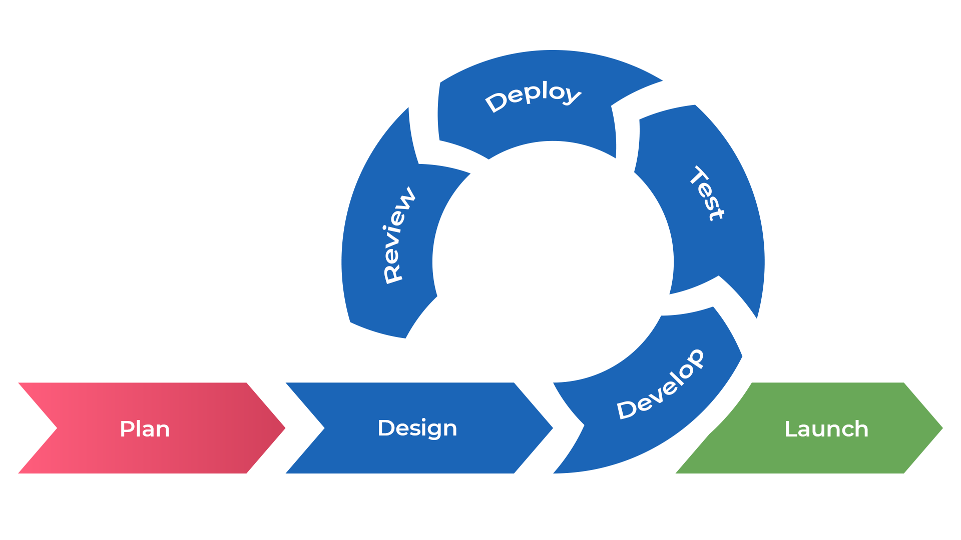
Brain Station 23 Development Methodology
Agile Method:
Figure 01: Agile methodology for software development

Slide 11
Accomplished Tasks

Slide 12
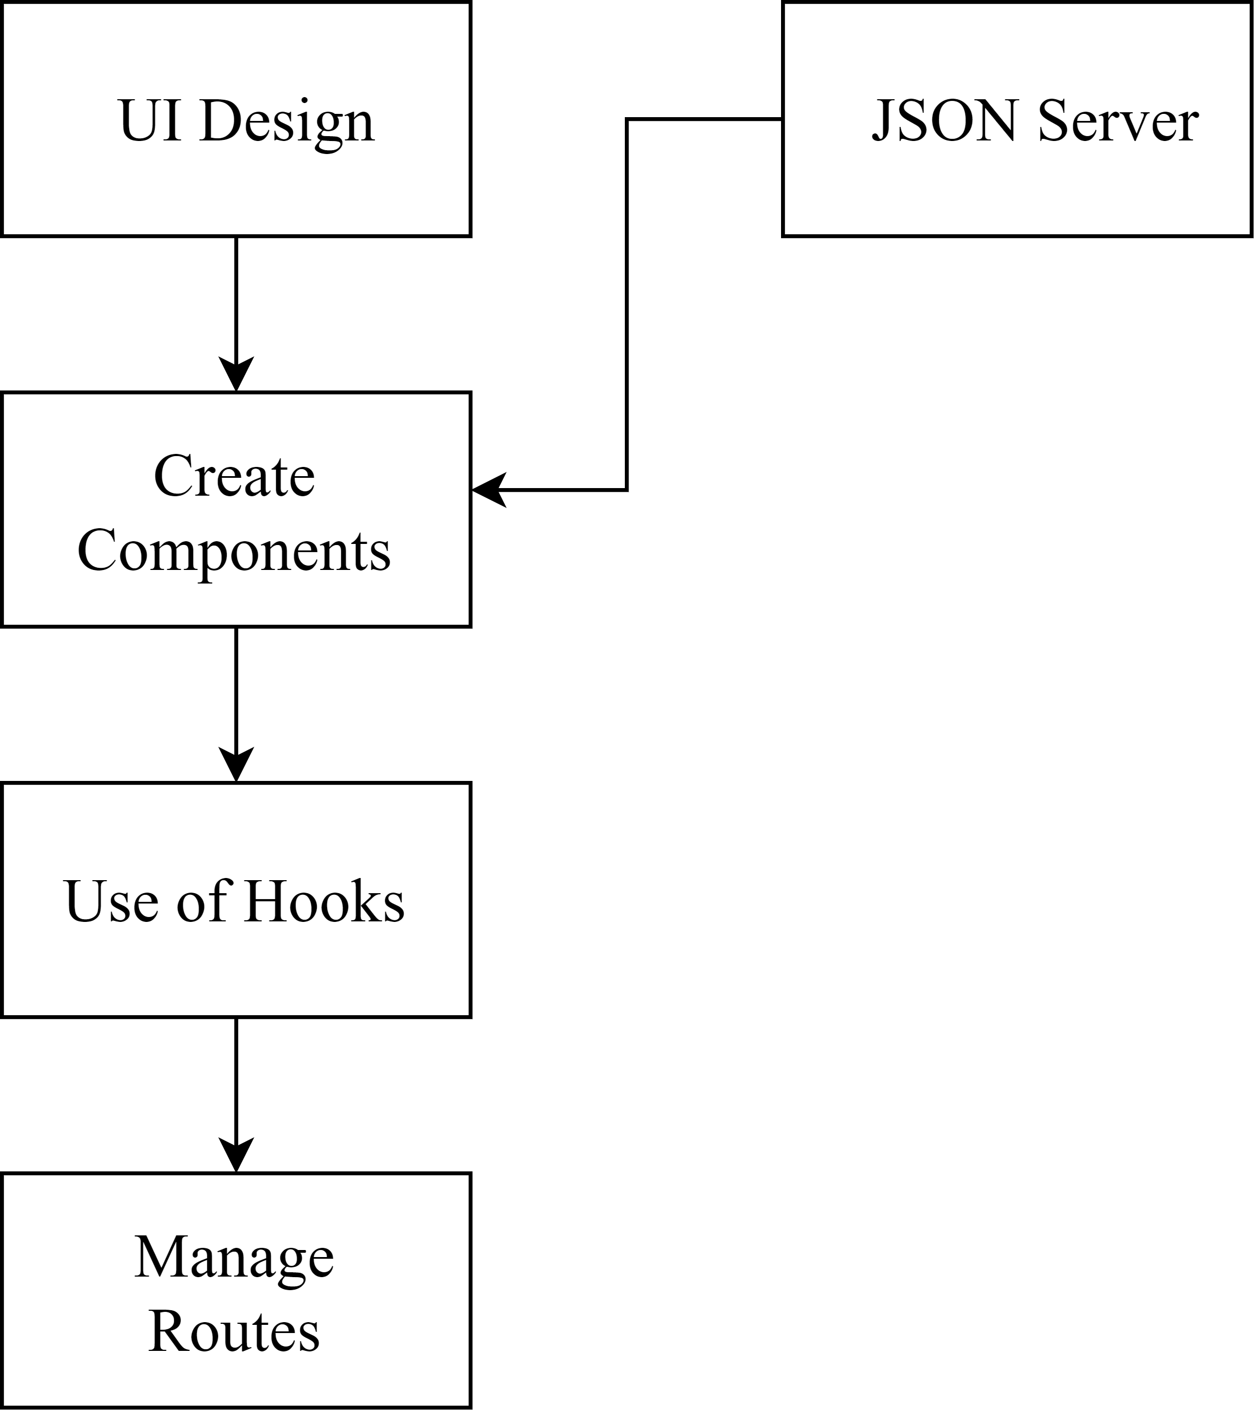
Accomplished Tasks (CONTD.)
Figure 02: Flowchart for Frontend development

Slide 13
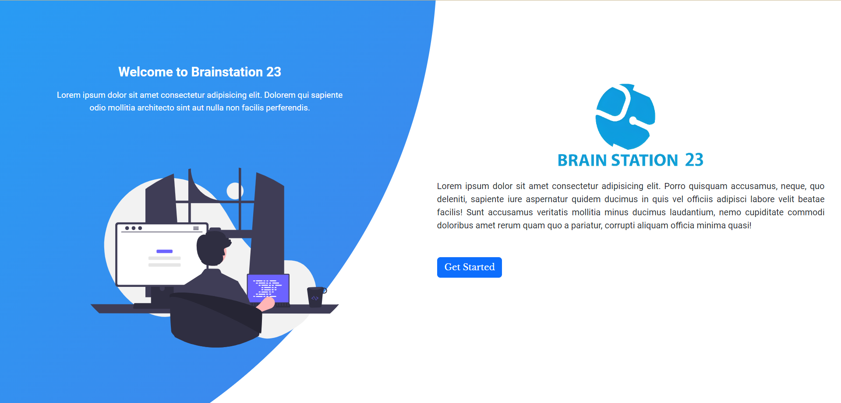
Accomplished Tasks (CONTD.)
Figure 04: Landing page

Slide 14
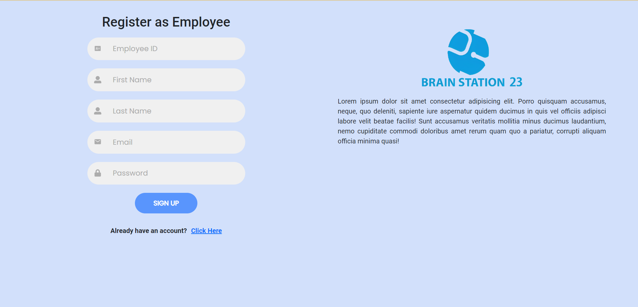
Accomplished Tasks (CONTD.)
Figure 05: Register as Employee

Slide 15

Accomplished Tasks (CONTD.)
Figure 06: Register as Admin

Slide 16
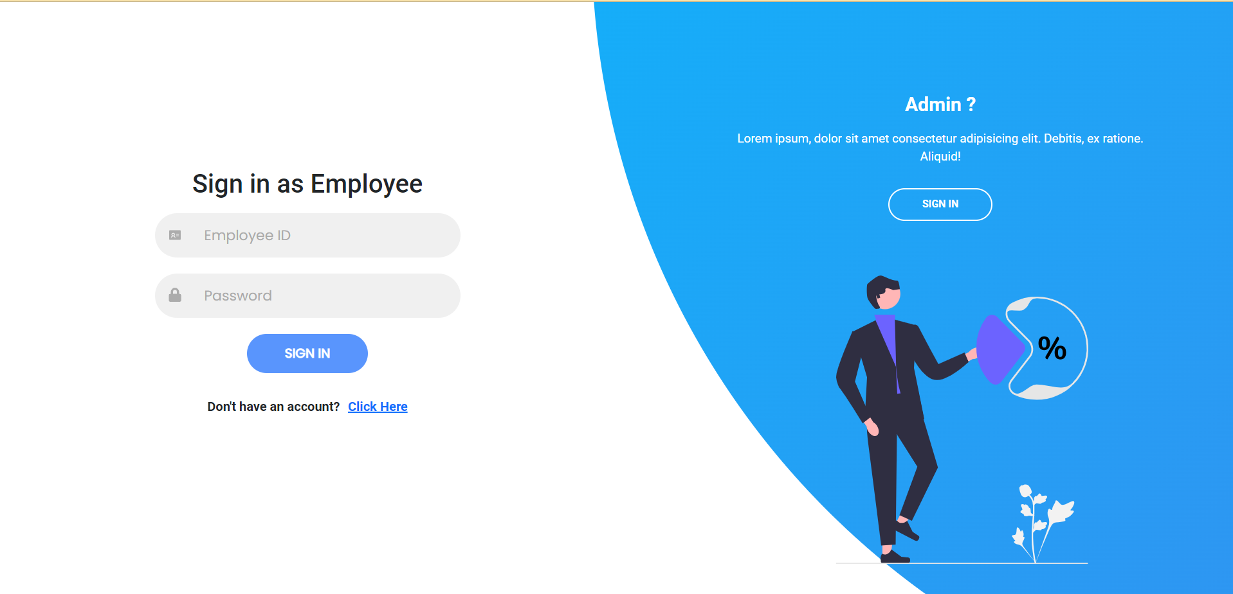
Accomplished Tasks (CONTD.)
Figure 07: Sign in as Employee

Slide 17
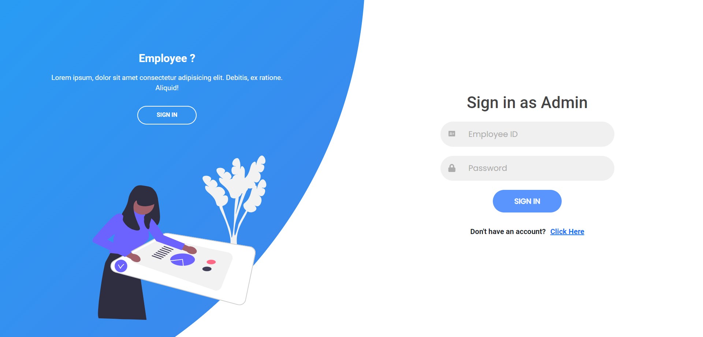
Accomplished Tasks (CONTD.)
Figure 08: Sign in as Admin

Slide 18

Accomplished Tasks (CONTD.)
Figure 09:Navigation Bar
Figure 10:Side Navigation Bar

Slide 19
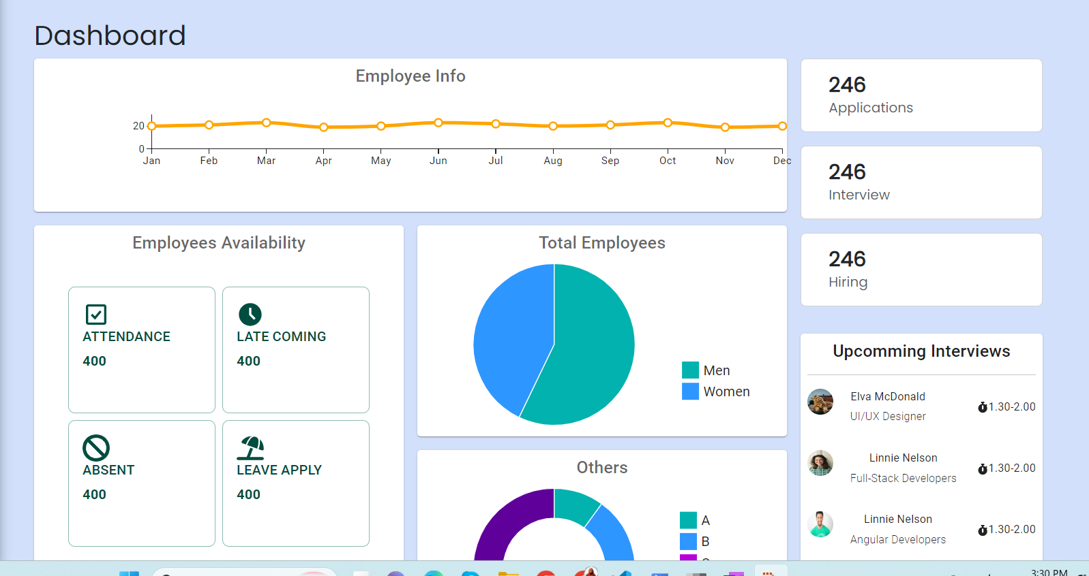
Accomplished Tasks (CONTD.)
Figure 11 : Dashboard

Slide 20
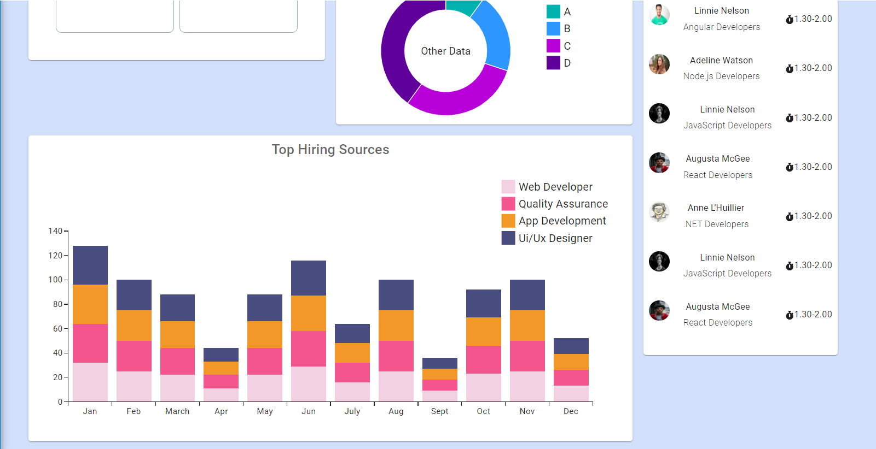
Accomplished Tasks (CONTD.)
Figure 12 : Dashboard (contd.)

Slide 21
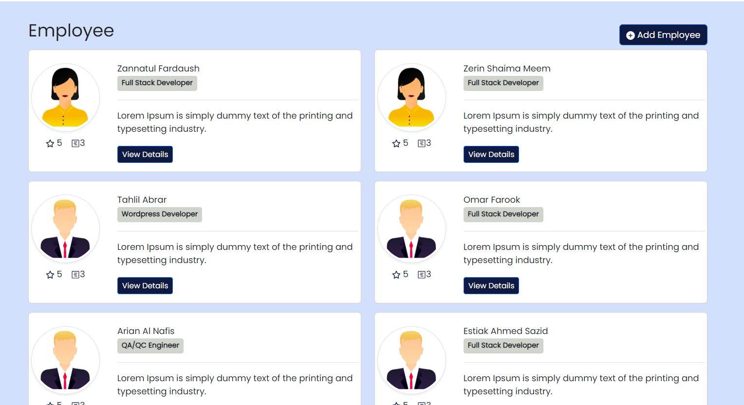
Accomplished Tasks (CONTD.)
Figure 13 :Employee List

Slide 22
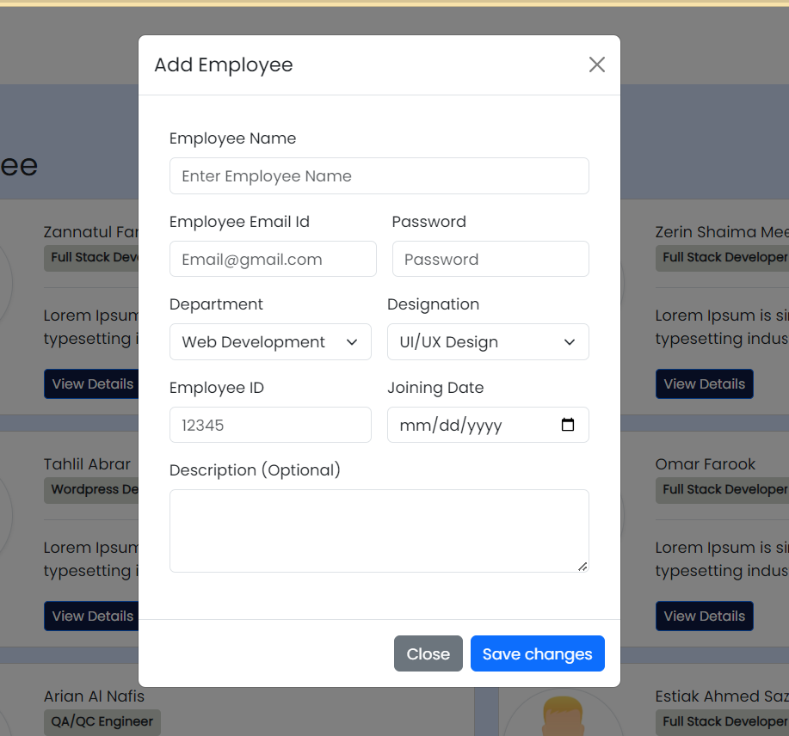
Accomplished Tasks (CONTD.)
Figure 14: Add Employee

Slide 23
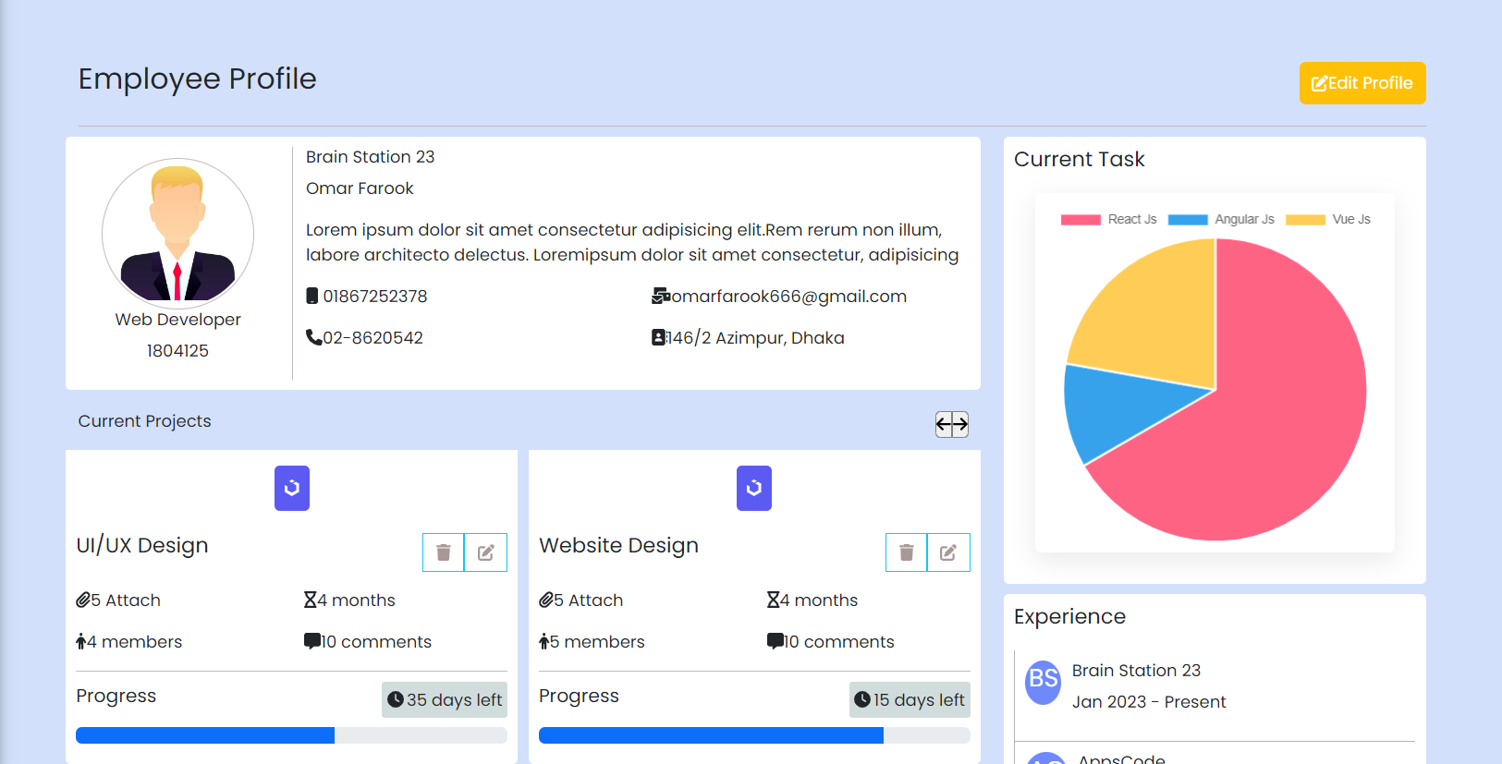
Figure 15: Employee Profile

Slide 24
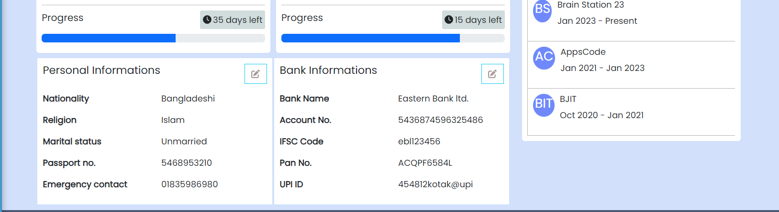
Accomplished Tasks (CONTD.)
Figure 16: Employee Profile(contd.)

Slide 25
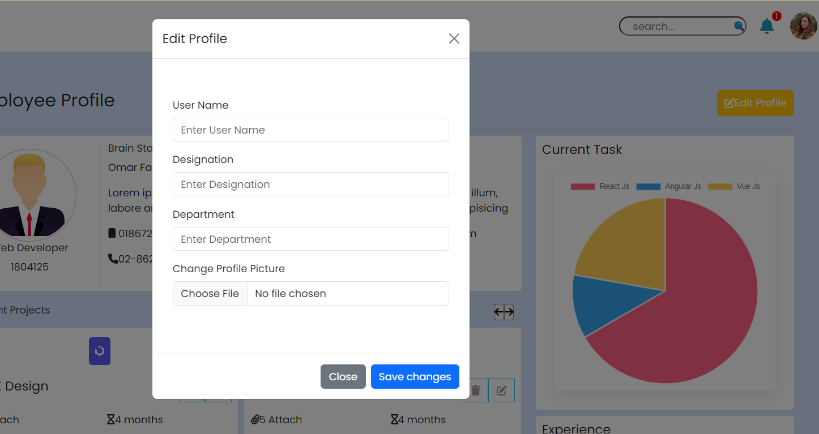
Figure 17: Edit Profile

Slide 26
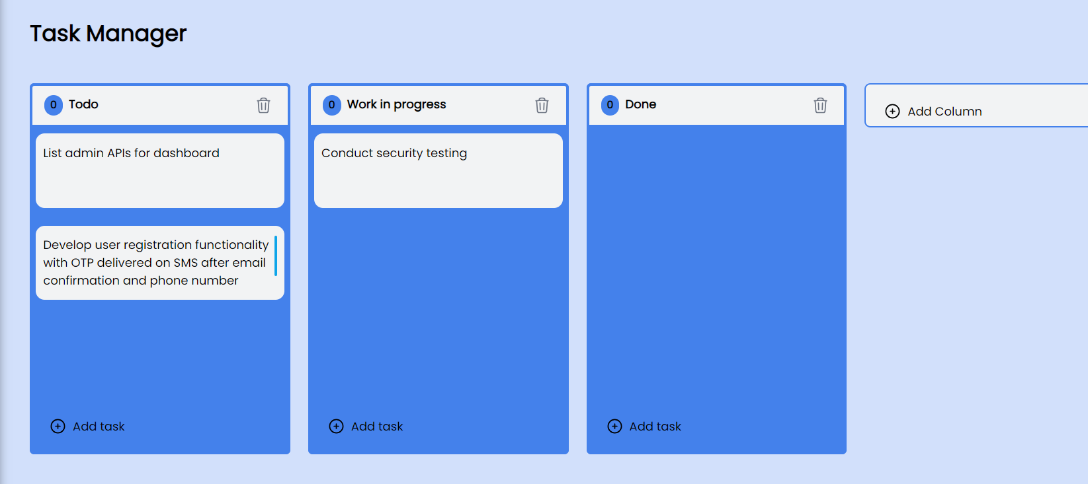
Figure 18:Task Manager

Slide 27
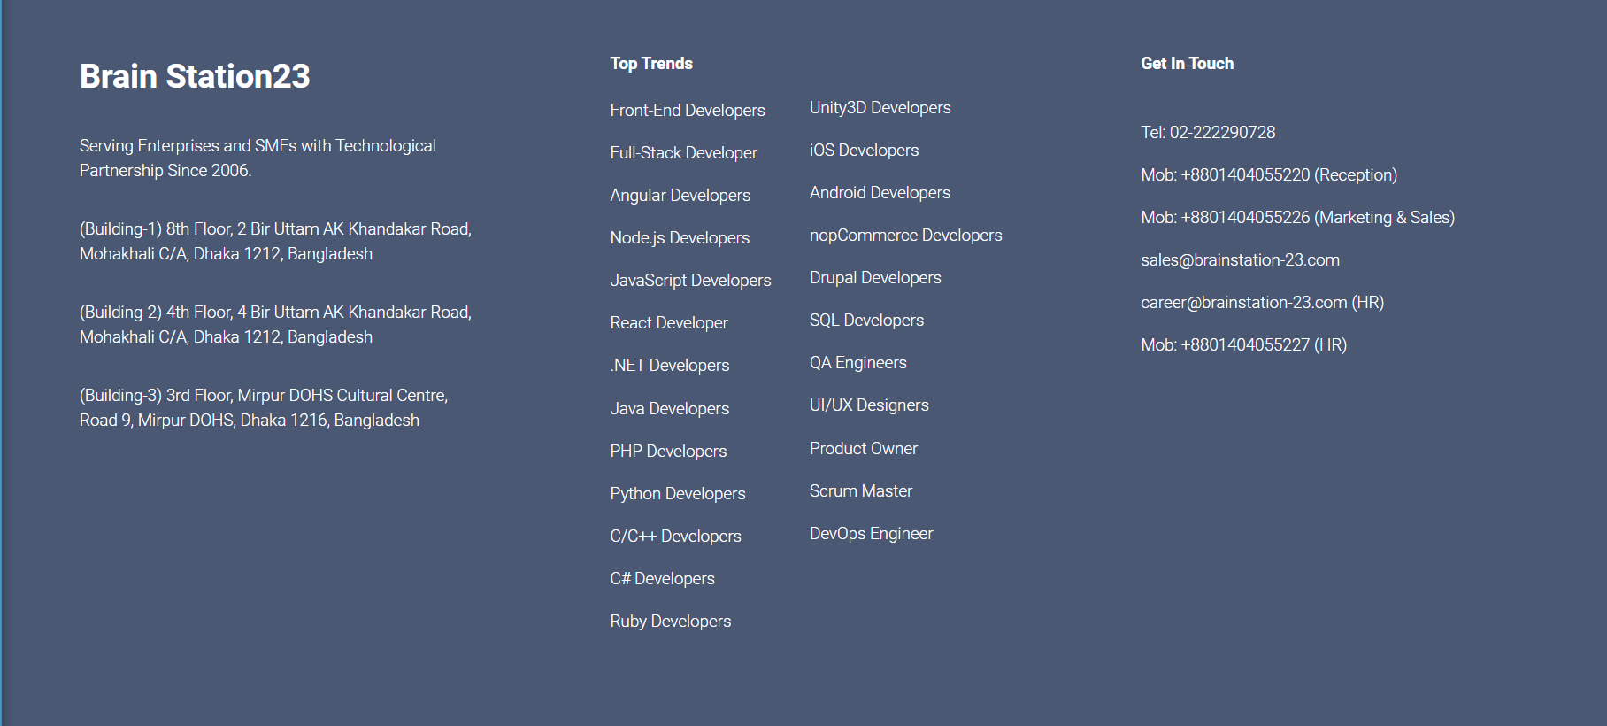
Figure 19: Footer

Slide 28
Control System Version
Implemented git to supervise the project
Using a cloud-based repository on github
Distributed version control software is available for free through open source
It is an online platform for software engineers to collaborate and manage version control

Slide 29
Conclusion

Slide 30
Thank You!

